Slide 1
Human-Robot Interaction:
Conducting a User Study and Analysing Data
by Talal Shaikh
*Multiple slides over the course adapted form Dr. Thusha Rajendran @HWU and Karola Pitsch @ University Duisburg-Essen
Dr. Katrin S. Lohan @HWU

Slide 2
User Studies
Design
Hypothesis
Population
Task
Setup
Procedure
Confounds/Biases
Metric
Data Analysis

Slide 3
User Studies recap: Hypothesis
Hypothesis:
E.g. Participants using language to explain how to stack-cups to a robot will take less time than participants using only gestures.
identify the Independent Variable and the Dependent Variable
NULL Hypothesis, Alternate Hypothesis 1,Alternate Hypothesis 2

Slide 4
User Studies recap: Population
Population:
people going through your study
Have lots of people from the general public or Select a niche population
The more, the better (n>20 is pretty good)

Slide 5
User Studies recap: Task
Task:
Identify the task that your participants will fulfil during a session of your experiment

Slide 6
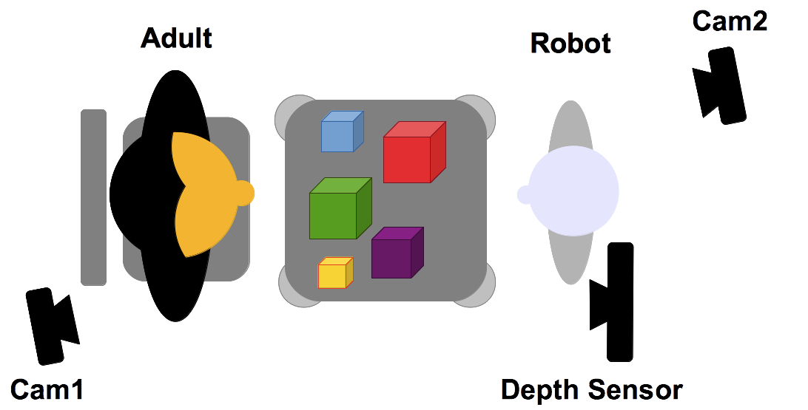
User Studies recap: Setup
Setup:
Describe the equipment you will use in your experiment
Describe the space you are using

Slide 7
Procedure
Formally have all participants sign up for a time slot (if individual testing is needed)
Informed Consent
Execute study
Questionnaires/Debriefing

Slide 8
Biases
Hypothesis Guessing
Participants guess what you are trying hypothesis
Experimenter Bias
Subconscious bias of data and evaluation to find what you want to find
Systematic Bias
bias resulting from a flaw integral to the system
E.g. an incorrectly calibrated thermostat
List of biases
http://en.wikipedia.org/wiki/List_of_cognitive_biases

Slide 9
Confounds
Confounding factors – factors that affect outcomes, but are not related to the study
Population confounds
Who you get?
How you get them?
How you reimburse them?
How do you know groups are equivalent?
Design confounds
Unequal treatment of conditions
Learning
Time spent

Slide 10
Metrics
What you are measuring
Types of metrics
Objective
Time to complete task
Errors
Ordinal/Continuous
Subjective
Satisfaction
Pros/Cons of each type?

Slide 11
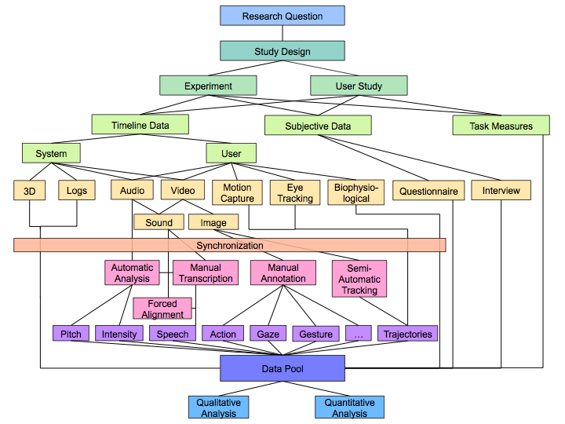
Data Analysis

Slide 12
Data Analysis: Qualitative Analysis
The most common method is the qualitative research are:
interviews
group discussions
observation and reflection field notes
various texts, pictures, and other materials
behavioural description/annotation
Case analysis: Ethnomethodological Conversation Analysis (EM/CA)

Slide 13
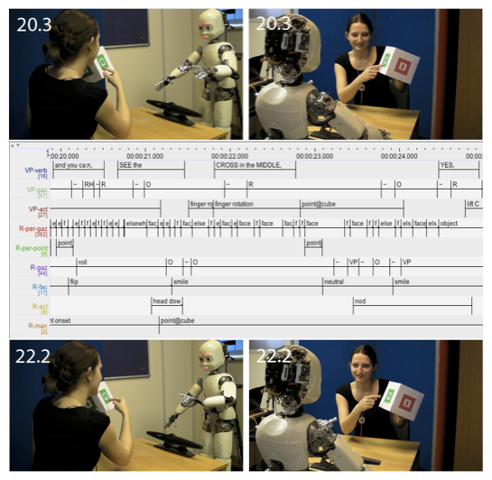
Data Analysis: Qualitative Analysis an example [1]
Data:
Setting: Video & Audio
Logfiles: Robot‘s perception & internal states [2]
2 external video cams
Timeline
Logfiles
Perception of gaze
Perception of pointing
Manual annotation
ELAN

Slide 14
Data Analysis: Qualitative Analysis an example
Method: Case analysis
Qualitative, explorative, generate hypotheses
Ethnomethodological Conversation Analysis (EM/CA)
Notes:
pfeile

Slide 15
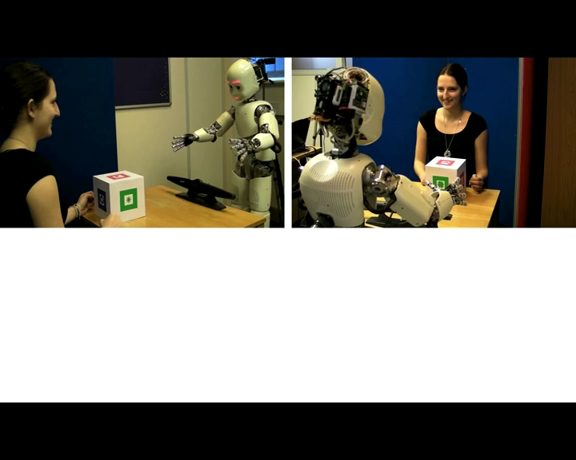
Data Analysis: Qualitative Analysis an example
Video-Clip: 00:12.00 – 00:16.50

Slide 16
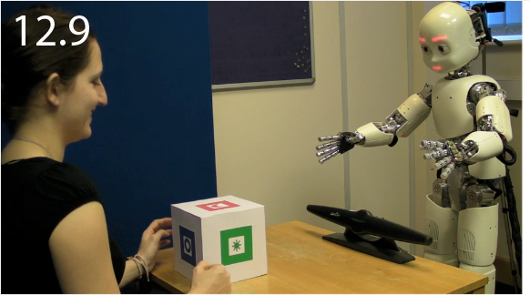
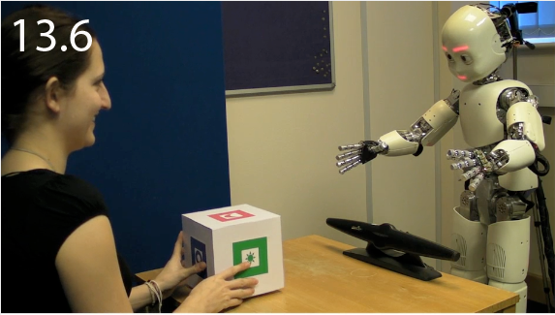
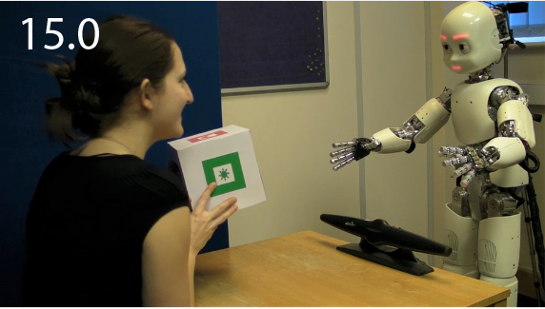
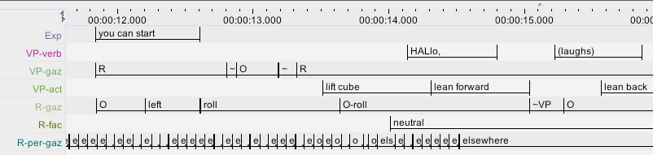
Data Analysis: Qualitative Analysis an example
(a) Beginning of interaction: RP-2 (Gaze at object)
(1) T gazes at object
(5) Tutor reacts by using elements of social interaction (greeting), to which robot appears to respond appropriately (look at her) → laughter
(2) Robot detects ‚T-gaze-at-object‘
Robot gazes at object
(4) T sees that robot gazes at object

Slide 17
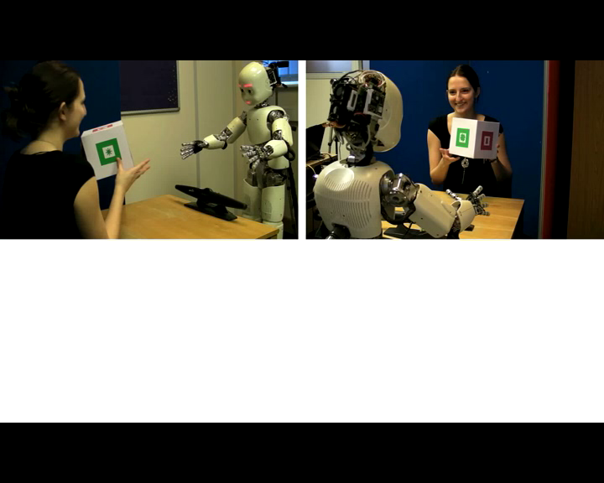
Data Analysis: Qualitative Analysis an example
(b) Explanation - 1: RP-3 (Gaze at partner)
Tutor gazes at robot> Robot gazes at tutor
Video-Clip: 00:16.00 – 00:20.00

Slide 18
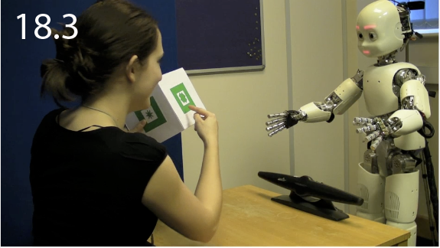
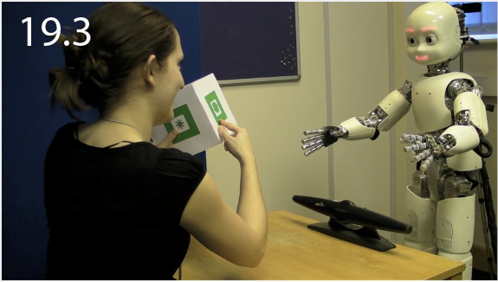
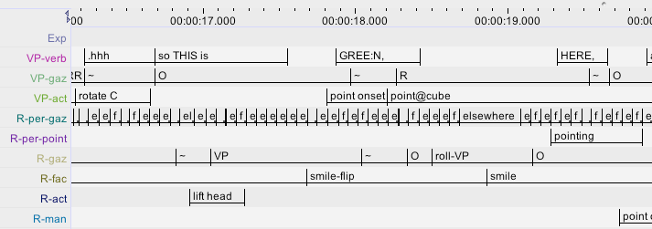
Data Analysis: Qualitative Analysis an example
(b) Explanation - 1: RP-3 (Gaze at partner)
T looks at robot and explains: „so THIS is GREE:N,“ → Gaze at end of
utterance + rising pitch + pause > Makes relevant: acknowledgement
(2) Robot detects ‘T-gazes-at-face’
Robot lifts head, gazes at tutor + smiles > provides acknowledgement
(4) Robot’s rolling eye movement: T treats it as “searching” → adds “HERE”

Slide 19
Data Analysis: Qualitative Analysis an example
Qualitative measures are used to:
e.g. explore behaviour strategies
results are case based
not easily up-scalable
can give you direction for quantitative measures

Slide 20
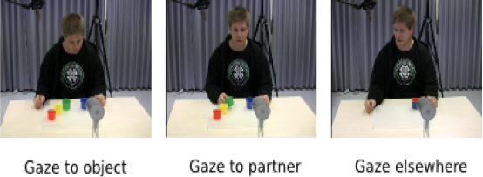
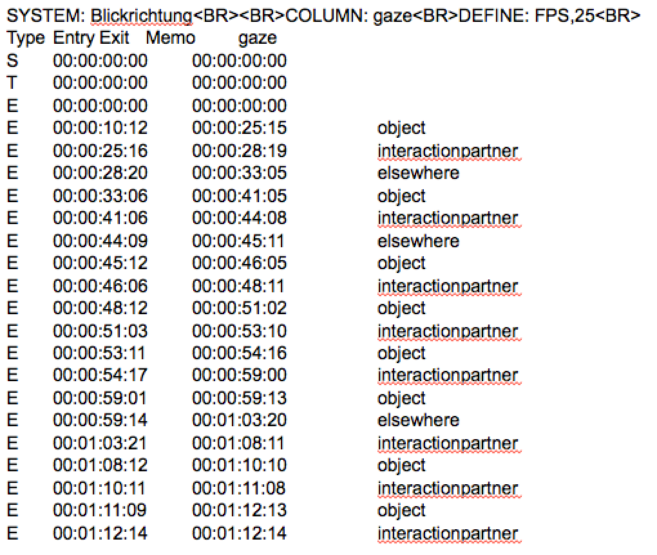
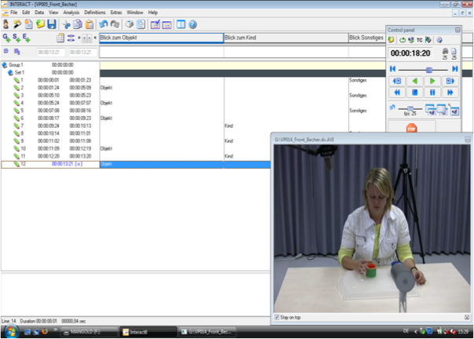
Data Analysis: Quantitative Analysis an Example

Slide 21
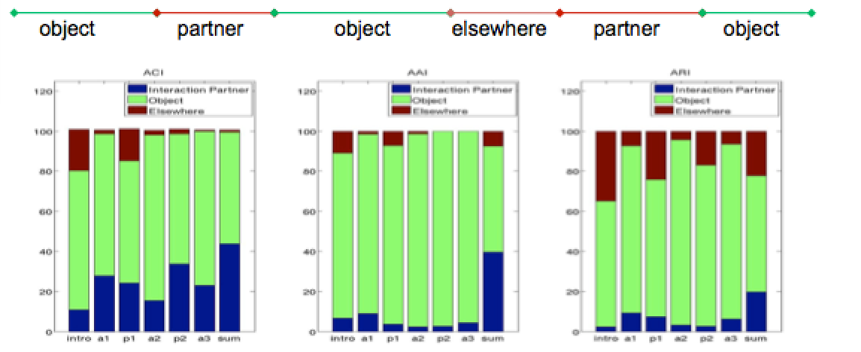
Data Analysis: Quantitative Analysis an Example
Total length of eye-gaze bouts to interaction partner/object/elsewhere: percentage of time of the action spent gazing at the interaction partner/object/elsewhere.
Frequency of eye-gaze bouts to interaction partner/object/elsewhere: eye gaze bouts per minute

Slide 22
Data Analysis: Quantitative Analysis
is quantising models in the experimental analysis
it analysis's concert numbers and values
parameters in the models hopefully have theoretical meaning beyond being used to fit models to data
can be run through a statistical test: e.g. t-test or ANOVA

Slide 23
Which ANOVA design to use?
Start
One
How many factors?
>1
Between subjects
Within
subjects
All between
subjects
All within
subjects
Design?
Factors?
One–Way ANOVA
Nonparametric
Kruskal-Wallis test
Jonckheere test
Nominal data
Chi-square test of association
Within subjects (repeated measures ANOVA)
Nonparametric
Friedman test
Correlated nominal data
Cochran’s Q test
Between subjects factorial ANOVA
Within subjects factorial ANOVA
Some between,
some within subjects
Mixed factorial ANOVA

Slide 24
What is Two-Way Mixed ANOVA? (you can have three-way, four-way etc.)
Two Independent Variables
Two-way = 2 IVs
Mixed:
1 Independent variable uses the same participants
1 Independent variable uses different participants
A.K.A. ‘Mixed-Plot Design’

Slide 25
Mixed factorial design
Between subjects factor (can’t be repeated measures in this particular case)
With-in subjects factor (can be and is repeated measures)
Text chat
Telephone
AS Group
Control Group
NB Counterbalancing to mitigate against order effects

Slide 26
References
[1] Lohan, K. S., Rohlfing, K. J., Pitsch, K., Saunders, J., Lehmann, H., Nehaniv, C. L., ... & Wrede, B. (2012). Tutor spotter: Proposing a feature set and evaluating it in a robotic system. International Journal of Social Robotics, 4(2), 131-146.
[2] Lohse, M., Hanheide, M., Pitsch, K., Rohlfing, K. J., & Sagerer, G. (2009). Improving hri design by applying systemic interaction analysis (sina). Interaction Studies, 10(3), 298-323. ISO 690
[3] Rajendran, G., & Mitchell, P. (2006). Text chat a tool for referential questioning in Asperger syndrome. Journal of Speech Language and Hearing Research, 49, 102-112.

Slide 27
How to calculate an ANOVA and what dose the result tell you?
Homework
use a Software like SPSS:
http://youtu.be/jYn5Jv7Gh4s
Read the referenced paper and try to summaries them with in 300 word each.

